Slide 1
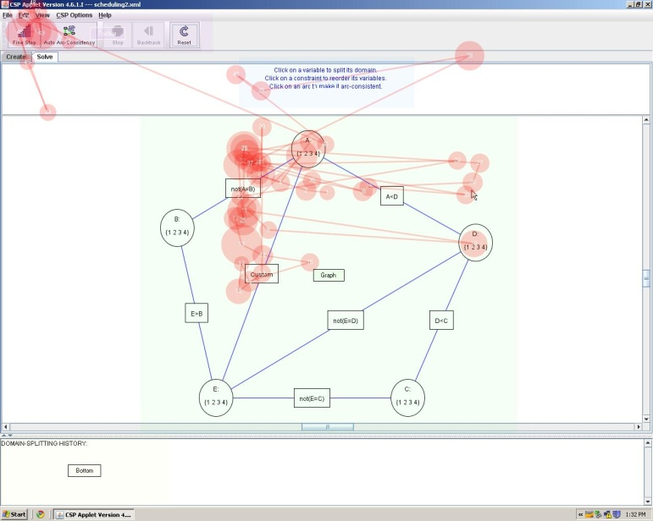
EMDAT v1.0
Samad Kardan
August 2012

Slide 2
Overview
Introduction
EMDAT input files
EMDAT core functionalities
How to use EMDAT

Slide 3
Overview
Introduction
EMDAT input files
EMDAT core functionalities
How to use EMDAT

Slide 4
Eye Gaze Measures
d
1
3
y
x
4
2
Basic measures derived from the literature:
Number of Fixations
Fixation rate
Fixation Duration
Saccade Length d
Relative Saccade Angles y
Absolute Saccade Angles x
Notes:
Fixation
Saccade
Fixation rate
Rate of eye fixations per milliseconds
Number of Fixations
Number of eye fixations detected during an interval of interest
Fixation Duration
Time duration of an individual fixation
Saccade Length
Distance between the two fixations delimiting the saccade (d)
Relative Saccade Angles
The angle between the two consecutive saccades (angle y)
Absolute Saccade Angles
The angle between a saccade and the horizontal (angle x)

Slide 5
Basic concepts
Area Of Interest (AOI)
A specific area on the screen studied separately
Segment and Scene
timeline
Seg 1
Seg 3
Seg 5
Scene 1

Slide 6
Overview
Introduction
EMDAT input files
EMDAT core functionalities
How to use EMDAT

Slide 7
Files from Tobii studio
Mandatory
All-Data
Fixation-Data
Optional
Event-Data
AOI definitions

Slide 8
Additional files
Mandatory
Segment definitions
Scene 3
timeline
Seg 10
Seg 11
Seg 1
Seg 2
Seg 3
Seg 4
Seg 5
Scene 2
Scene 1

Slide 9
Additional files
Optional
Extended AOI definitions
Dynamic AOIs
Time intervals

Slide 10
Overview
Introduction
EMDAT input files
EMDAT core functionalities
How to use EMDAT

Slide 11
Main modules
Scene and Segment classes
AOI and AOI_Stat classes
Recording class
Participant class
BasicParticipant class

Slide 12
Eye movement features
General features for each segment
Duration
Number of Fixations
Fixation rate
Average, sum and standard deviation for
Fixation Duration
Saccade Length
Relative Saccade Angles
Absolute Saccade Angles

Slide 13
Eye movement features
AOI based features
Fixation based features
Fixation rate
Absolute value and ratio of
Time spent
Number of Fixations
Longest fixation
Time to first fixation
Time to last fixation
Transitions between AOIs
Number rand ratio

Slide 14
Quality of gaze data
Validity evaluation methods
Proportion valid
Largest invalid gap
Restoring invalid samples
Improving segment quality
Looking at x,y
Looking at x,y
Looking at x,y
Segment 1
Segment 11
Segment 12

Slide 15
Overview
Introduction
EMDAT input files
EMDAT core functionalities
How to use EMDAT

Slide 16
Steps
Export necessary files from Tobii studio
At least All-Data and Fixation-Data
Generate ‘.seg’ and if needed ‘.aoi’ files
Can be created manually
Change the sample BasicParticipant class or implement a new Participant subclass
Minimal changes

Slide 17
Steps
Set EMDAT parameters
Params.py
Validity method, name of AOIs, number of header lines in exported files from Tobii, etc.
Run the test script to calculate and export the features

Slide 18
Thank you
Questions

Slide 20
Problem 1
Problem 2
timeline
Seg 1
Seg 2
Seg 3
Seg 4
Seg 5
“Look Away” events

Slide 21
Before
Segment 1
Automatic Splitting
After
Segment 11
Segment 12

